Slide 1
“Online Medical Support System” Group Number : 16
Contributions of different members
Imam Hossain (18301276): Intro and Activity Diagram
Inzamam M. Hasan (17301059): Use Case Diagram and Summary
Miftahul Jannah (13201085): Requirements and Class diagram
Notes:
1

Slide 2
Explain About your Project
To ensure medical support instantly and to make it hassle free.
This system will link patients with doctors and other medical services
Planning to make it Easy, User-friendly and Convenient
2

Slide 3
Requirement analysis
Functional Requirements :
All doctors will be categorized
• Patients can search for doctors
• Patients can view doctors’ profiles
• Patients can make appointments online
• There will be live consultation option
• Patients can bring doctors home
• Patients can access to and take services from blood banks, hospitals, pharmacy and ambulance through the system
Non-functional Requirements :
• System will have access credentials.
• System will require location services.
• System must ensure users’ data and privacy.
• Searching option should be optimized.
• System will have sorting option. Such as sort by location, sort by fees etc.
3

Slide 4
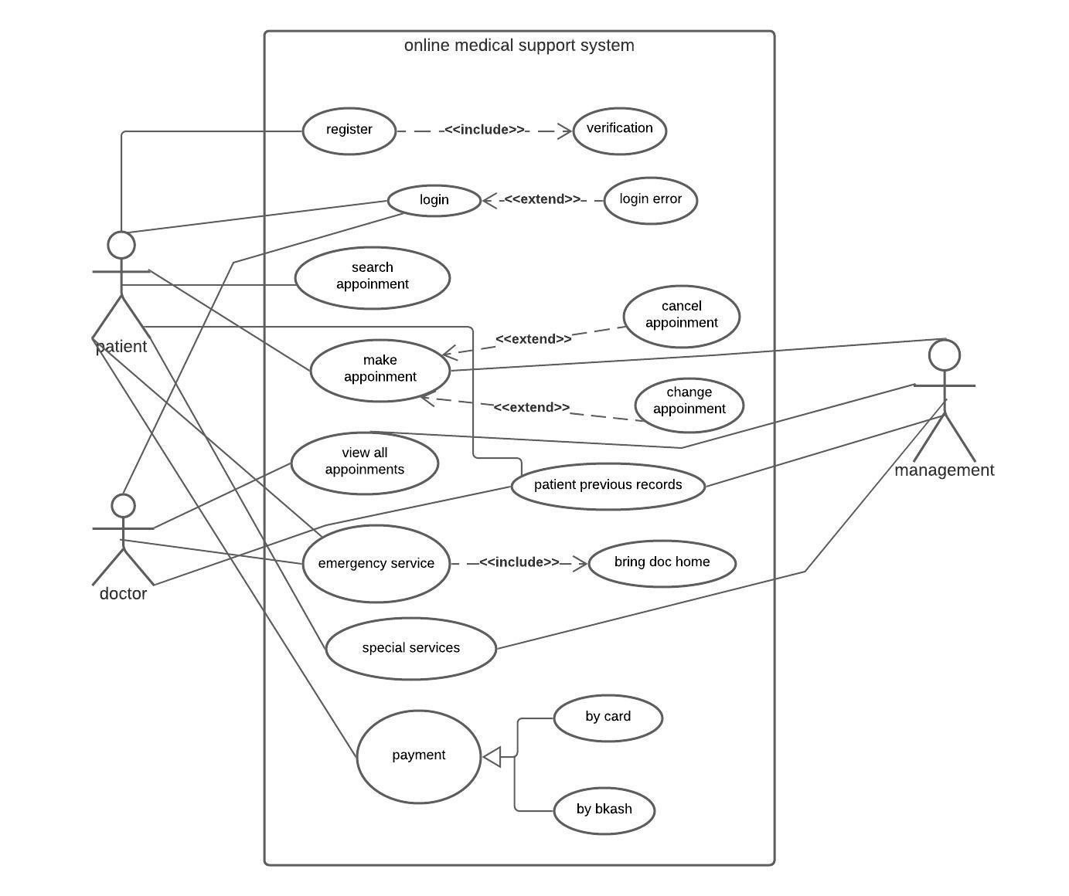
USE Case Diagram
4

Slide 5
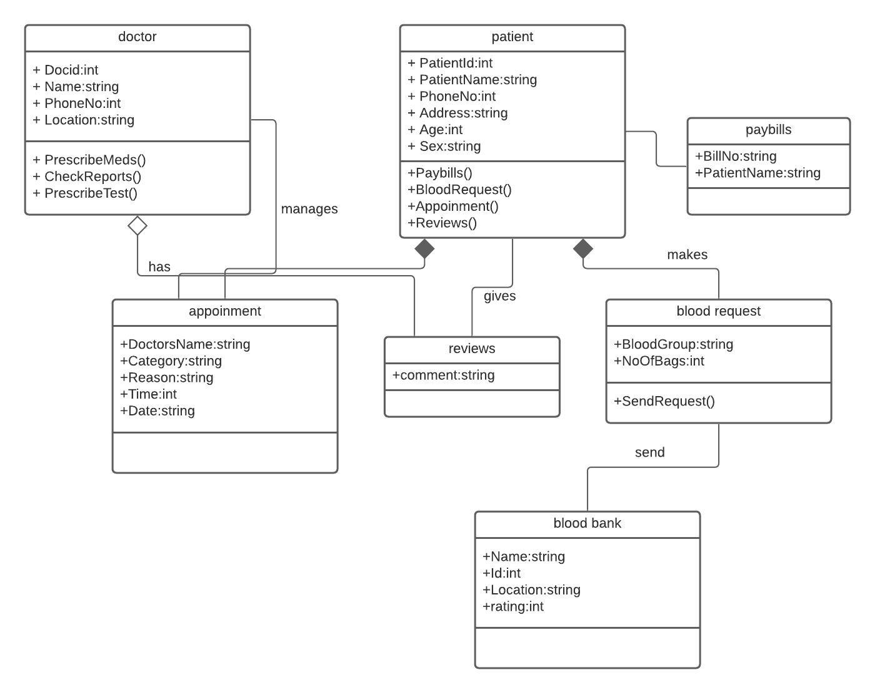
Class Diagram
5

Slide 6
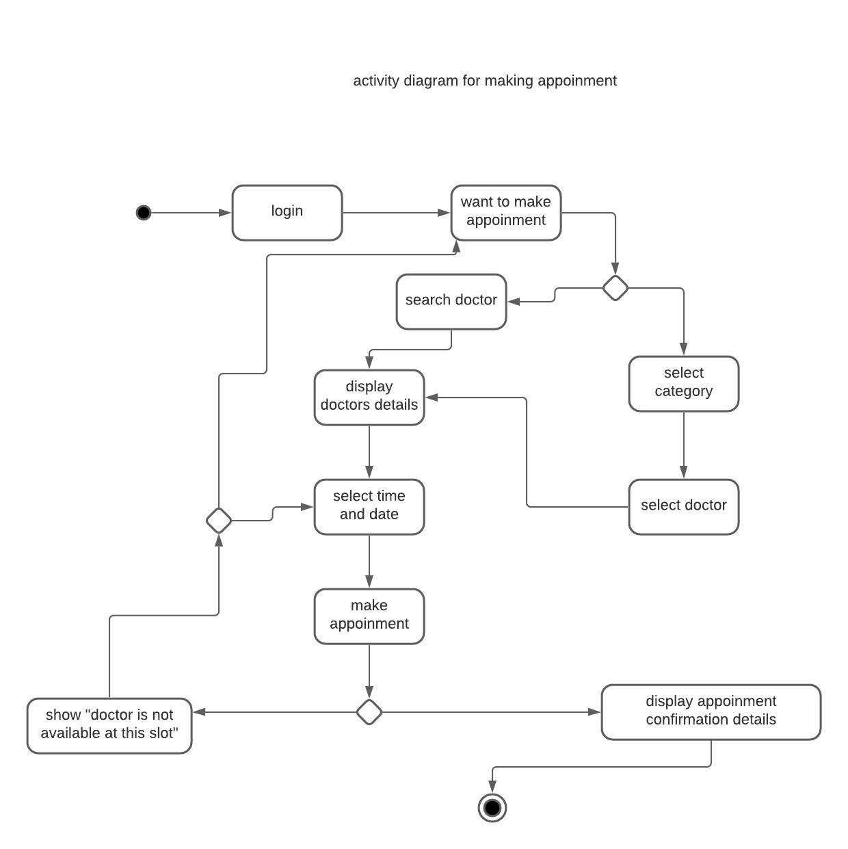
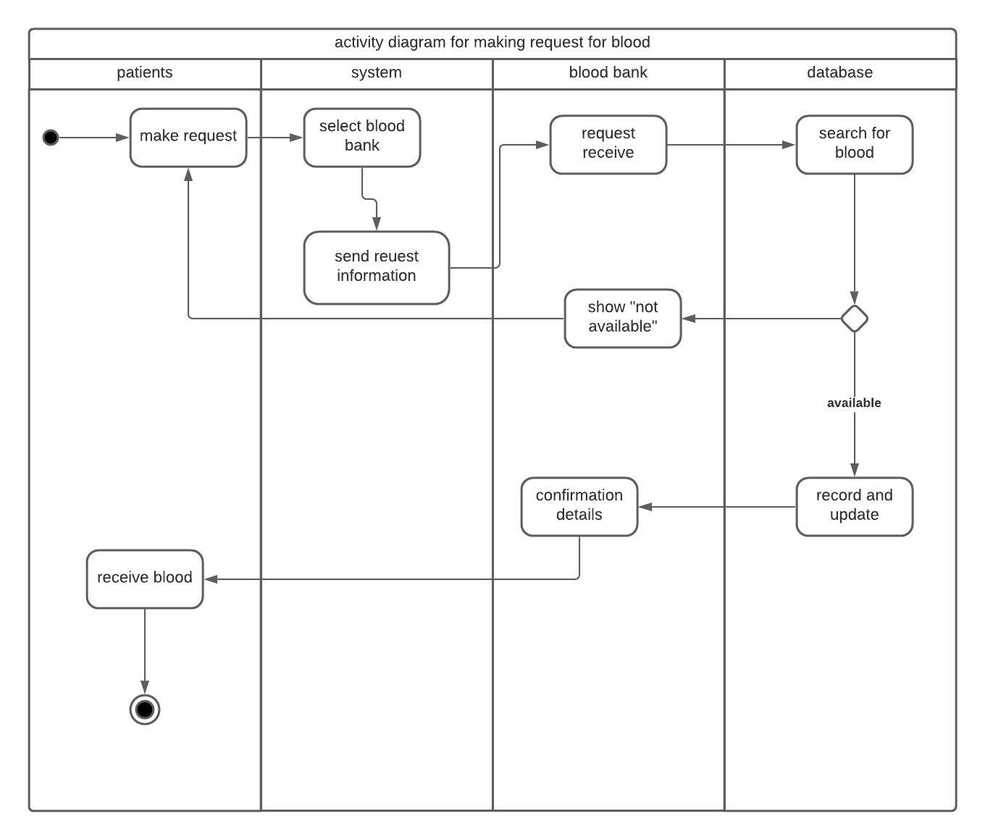
Activity Diagram
6

Slide 7
Sequence Diagram
7

Slide 8
DFD Diagram
8

Slide 9
Summary and Conclusion
-we are providing easier and cheaper service to our customers.
-we expect to have increased revenue and brand recognition.
-Our system will also ensure security while offering an improved technology.
9

